Slide 1

Scrum-Agile
By: Ethan Hutchison

Slide 2
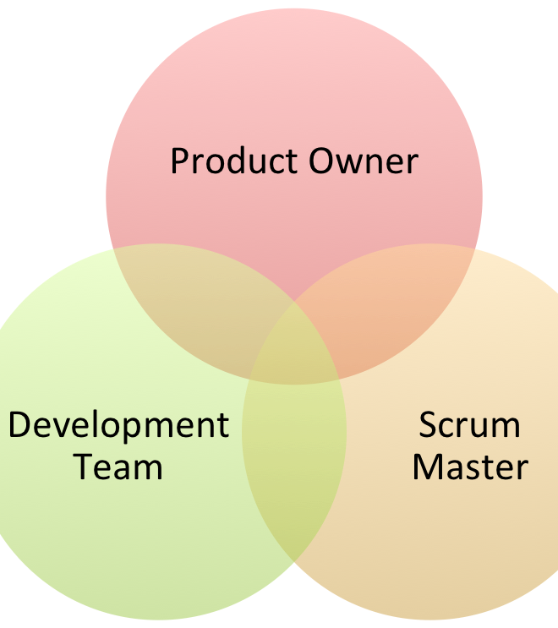
Roles
Product Owner – The product owner is a projects key stakeholder and oversees communicating with users and the clients about the project.
Scrum Master – The scrum master is the one that leads the team using agile principles, they work closely with the product owner and plan out the sprints.
Development team – The development team is the group that does much of the hard work on the project such as coding and designing while also creating test cases to make sure the program follows criteria.

Slide 3

Stages
Planning – Agile fits into the planning process by having the Scrum Master and the Product Owner working to plan the sprint and selecting from the product backlog.
Defining – The requirements are defined by the Product Owner collecting user stories and communicating with the clients.
Designing – The scrum master, product owner and development team work together to design the project. Letting the team choose items to work on also gives them more confidence to design parts of that item as well.
Developing – The development stage fits in perfectly because it is working on the project, but agile lets the developers pick their own task to work on from a list given.
Testing – Testing is done very closely with the development of the project and uses the user stories provided earlier in the process.
Deployment – Deployment fits perfectly at the end of the process in agile because it is the end goal of the entire process

Slide 4
What About Waterfall?
With the waterfall approach the process would been much more linear. The entire project would have been mapped out from the beginning and the order of each step would be decided on. The teams would have had items assigned to them for that stage of the project. It would have been a harder to deal with changes in the later stages of the project like had happened in the SNHU Travel project. It also would not have involved the product owner or client as much after the end goal was defined.

Slide 5
Agile vs waterfall
agile
Waterfall
Is more flexible with changes
Lets the team push themselves and pick items they want
Open communication
Works in large and small projects
Involves client and product owner
Good for projects where the final stages are not known yet
Much more linear
Not as flexible
Can work fine for small project
Doesn’t involve client and product owner
Fixed budget and deadline
Better for strictly defined items or projects with regulations.

Slide 6
Sources
Hoory, L. (2022, August 10). Agile vs. waterfall: Which project management methodology is best for you? Forbes. Retrieved April 16, 2023, from https://www.forbes.com/advisor/business/agile-vs-waterfall-methodology/
SDLC - Overview. Tutorials Point. (n.d.). Retrieved April 16, 2023, from https://www.tutorialspoint.com/sdlc/sdlc_overview.htm

